Slide 1
Causes of Behavior
“[S]omething essential to scientific practice is missing in (…) discussions of human behavior. It has to do with (…) the causes of behavior.”
“Intelligent people no longer believe that men are possessed by demons (although the exorcism of devils is occasionally practiced, and the demonic has reappeared in the writings of psychotherapists), but human behavior is still commonly attributed to indwelling agents. A juvenile delinquent is said, for example, to be suffering form a disturbed personality.” (emphasis added).
“[T]he behavioral sciences still appeal to (…) internal states.” (emphasis added). (Skinner, 1971)

Slide 2
Determinism
“[A]lmost everyone attributes human behavior to intentions, purposes, aims, and goals.”
“The task of scientific analysis is to explain how the behavior of a person as physical system is related to (…) the conditions under which the individual lives.
“A scientific analysis of behavior must, I believe, assume that a person’s behavior is controlled by his genetic and environmental history rather than by the person himself as an initiating, creative agent.” Skinner, 1974.
People can be controlled by controlling their environmental history.

Slide 4
Question #1
Which graph(s) provide evidence that the rats learned to navigate the maze?
Curve 1 (group 1) provides evidence that those rats learned the maze.
Curve 2 (group 2) provides evidence that those rats learned the maze.
Both curves provide evidence that those rats learned the maze.
Neither curve 1 nor curve 2 provides evidence that those rats learned the maze.

Slide 5
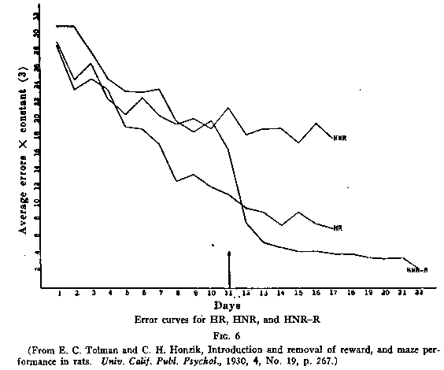

Slide 6
Question #2
Examine the curve representing group 3 and explain why that curve does or does not indicate that those rats learned the maze prior to administration of the reward.

Slide 7
Question #3
(a) Based on the data provided by the third group of rats (curve 3) what can you say about whether or not the other groups of rats (groups 1 and 2) were learning the maze?
(b) Taken together, what do the findings depicted in these 3 curves, representing 3 different conditions regarding the presence of rewards, indicate about the role of rewards in learning?
Notes:
Does the data represented in curve 3 change your idea about whether or not those other groups of rats were learning?

Slide 8
Is Behavior (S R) Lawful?
Consider first Skinner's use of the notions stimulus and response. In Behavior of Organisms he commits himself to the narrow definitions for these terms.
A part of the environment and a part of behavior are called stimulus (eliciting, discriminated, or reinforcing) and response, respectively, only if they are lawfully related; that is, if the dynamic laws relating them show smooth and reproducible curves.
Evidently, stimuli and responses, so defined, have not been shown to figure very widely in ordinary human behavior. We can, in the face of presently available evidence, continue to maintain the lawfulness of the relation between stimulus and response only by depriving them of their objective character.

Slide 9
Where is the Stimulus?
“A typical example of stimulus control for Skinner would be the response to a piece of music with the utterance Mozart or to a painting with the response Dutch. These responses are asserted to be "under the control of extremely subtle properties" of the physical object or event. Suppose instead of saying Dutch we had said Clashes with the wallpaper, I thought you liked abstract work, Never saw it before, Tilted, Hanging too low, Beautiful, Hideous, Remember our camping trip last summer?, or whatever else might come into our minds when looking at a picture (in Skinnerian translation, whatever other responses exist in sufficient strength).
Skinner could only say that each of these responses is under the control of some other stimulus property of the physical object. If we look at a red chair and say red, the response is under the control of the stimulus redness; if we say chair, it is under the control of the collection of properties (for Skinner, the object) chairness, and similarly for any other response.

Slide 10
Do Stimuli Exist Independently of the Subject?
This device is as simple as it is empty. Since properties are free for the asking (we have as many of them as we have nonsynonymous descriptive expressions in our language, whatever this means exactly), we can account for a wide class of responses in terms of Skinnerian functional analysis by identifying the controlling stimuli.
But the word stimulus has lost all objectivity in this usage. Stimuli are no longer part of the outside physical world; they are driven back into the organism. We identify the stimulus when we hear the response. It is clear from such examples, which abound, that the talk of stimulus control simply disguises a complete retreat to mentalistic psychology.
We cannot predict verbal behavior in terms of the stimuli in the speaker's environment, since we do not know what the current stimuli are until he responds. Furthermore, since we cannot control the property of a physical object to which an individual will respond, except in highly artificial cases, Skinner's claim that his system, as opposed to the traditional one, permits the practical control of verbal behavior is quite false.”
Chomsky, N. (1959), emphasis added.

Slide 11
Skinner recognized the existence of such inner states as drives and self-awareness, but he rejected the notion that they can explain behavior.
Drives refer to the effects of deprivation and satiation and thus are related to the probability of certain behaviors, but they are not the causes of behavior.
Skinner believed that emotions can be accounted for by the contingencies of survival and the contingencies of reinforcement; but like drives, they do not cause behavior.
Similarly, purpose and intention are not causes of behavior, although they are sensations that exist within the skin.
Skinner explained creativity as the result of random or accidental behaviors that happen to be rewarded.

Slide 12
Ultimately, all of a person's behavior is controlled by the environment.
Societies exercise control over their members through laws, rules, and customs that transcend any one person's means of counter-control.
There are four basic methods of social control:
(1) operant conditioning, including positive and negative reinforcement and punishment;
(2) describing contingencies, or using language to inform people of the consequence of their behaviors;
(3) deprivation and satiation, techniques that increase the likelihood that people will behave in a certain way; and
(4) physical restraint, including the jailing of criminals.

Slide 13
Power to Control Behavior
How is behaviorism (learning theories) different from psychodynamic theories (e.g., psychoanalysis)?
Causation: internal vs. external
Agency vs. Determinism
How could neurosis be explained in behavioral terms?
Applications: how are psychodynamic and behavioral theories different?

