Slide 1
Behaviorism
3.23.2019

Slide 2
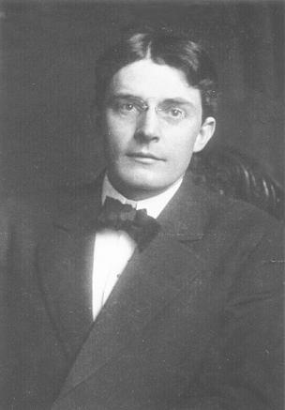
“Probably the most immediate result of the acceptance of the behaviorists view will be the elimination of self-observation and of the introspective reports resulting from such a method” (Watson, 1913, p. 428).

Slide 3
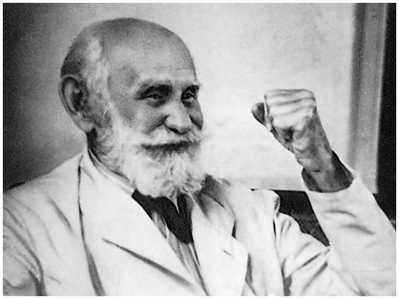
“It is logical that in its analysis of the various activities of living matter, physiology should base itself on the more advances and more exact sciences, physics and chemistry. But if we attempt an approach from this science of psychology...we shall be building of superstructure on a science that as no claim to exactness...In fact, it is still open to discussion whether psychology is a natural science, or whether it can be regarded as a science at all” (p. 3)

Slide 4
“Let us limit ourselves to things that can be observed, and formulate laws concerning only those things. Now what can we observe? We can observe behavior – what the organism does...” (Watson, 1925, p. 6)

Slide 5
Behaviorism: Theoretical Principles
Pavlov and John B. Watson shared a disdain for mentalistic concepts
1920’s Watson called for a new psychology that deemed studying inner thoughts, feelings, and motives as unscientific
Psychology should be an objective science based on studying observable behavior
Its theoretical goal is the prediction and control of behavior.
Behaviorism was highly influential in the United States during the first half of the 20th century
Notes:
Like John B. Watson before him, B. F. Skinner declared that the aim of behavioral science is the prediction and control of behavior.
and a belief that the laws that govern learning were the same for all animals, including humanIntrospection forms no essential part of its methods
Introspection forms no essential part of its methods

Slide 6
John B. Watson
Watson argued, our emotions exist in us because we have been conditioned to respond emotionally to certain stimuli that we encounter
All behavior was a product of learning:
“Give me a dozen healthy infants, well-formed, and my own special world to being them up in, and I’ll guarantee to take any one at random and train him to become any type of specialist I might select -- doctor, lawyer, artist, merchant, and, yes, beggarman and thief”

Slide 7
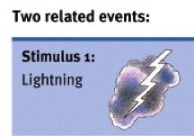
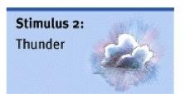
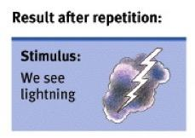
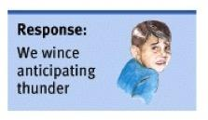
Learning through associating one stimulus with another

Slide 9
How do we learn?
By linking two events that occur close together, we exhibit associative learning
Aristotle, Locke, and Hume agree: We learn by association
We learn by connecting events that occur in sequence
Associative learning takes two forms:
Classical Conditioning
Operant Conditioning

Slide 10
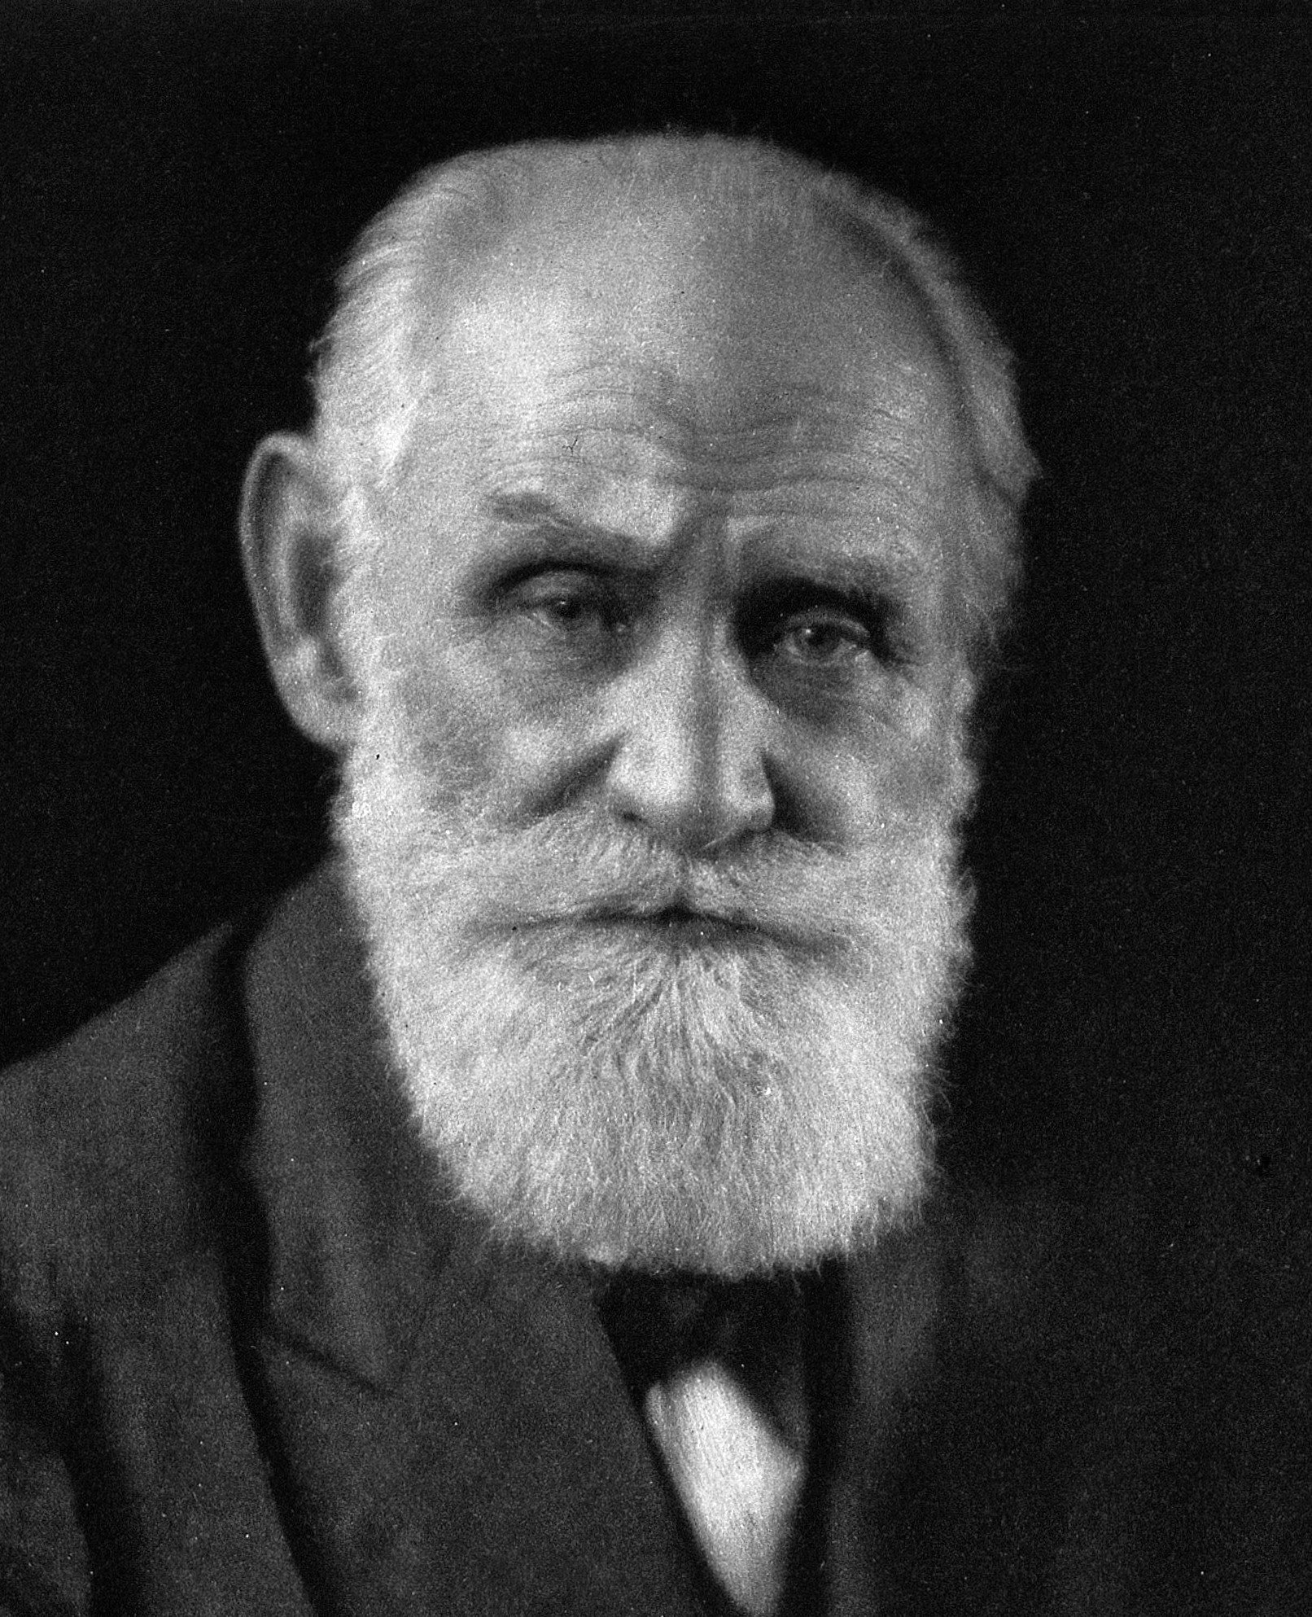
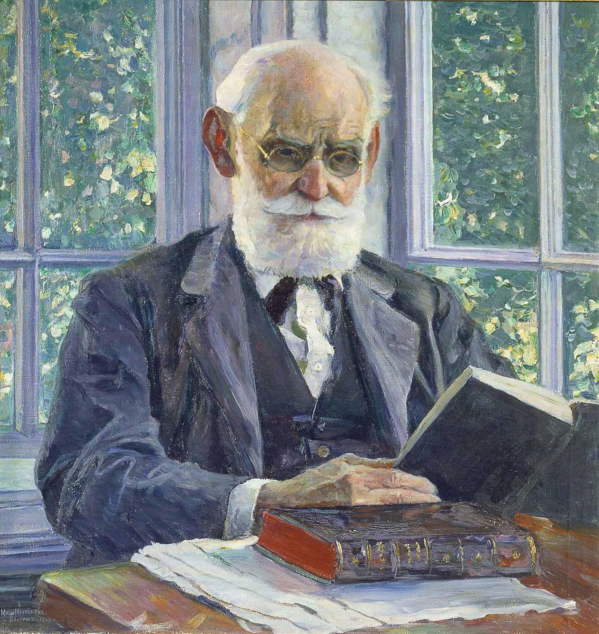
Ivan Pavlov (1849-1936)
Born in Russia
Received medical degree and became a physiologist at age 33
His studies on the digestive system earned him Russia’s first Nobel Prize in 1904
His contribution to psychology started from an incidental observation with his study on dogs and their digestive system

Slide 11
Historical Context: Pavlov’s Dog study
(1880’s) Psychology was a very young field; Not considered a scientific
Pavlov’s physiological research involved the use of dogs as subjects for studying the role of salivation on digestion
https://www.youtube.com/watch?v=asmXyJaXBC8

Slide 12
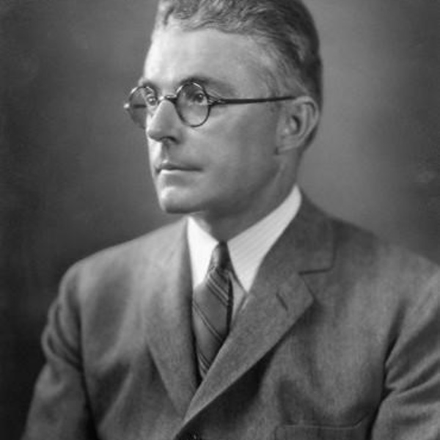
John B. Watson
Another study that rest directly on Pavlov’s theory of classical conditioning is John B. Watson’s conditioning of Little Albert to fear a white rat (and other furry animals) by employing the principles of classical conditioning
Watson sought to demonstrate how emotions, such as fear are formed
The historical importance of the Little Albert study is not only due to its findings, but also to the new psychological territory it pioneered

Slide 13
Little Albert experiment and context
Have you ever wondered where your emotions come from?
The source of emotions has fascinated scientists throughout history
During the 1920’s - psychology was dominated by Freud and psychoanalysis
Behavior, thoughts, and emotions are motivated by unconscious forces and repressed conflicts from early childhood
During this time, Behaviorism, was radically opposed to psychoanalysis and argued that behavior is motivated outside the person through environmental stimuli

Slide 14
Little Albert: Video and Conclusion
Little Albert: https://www.youtube.com/watch?v=9hBfnXACsOI
Watson theorized that if a stimulus automatically produces a certain emotion in you and that stimulus is repeatedly experienced at the same moment with something else, such as a rat, the rat will become associated with fear
We are not born to fear rats but such fears are learned through conditioning

Slide 15
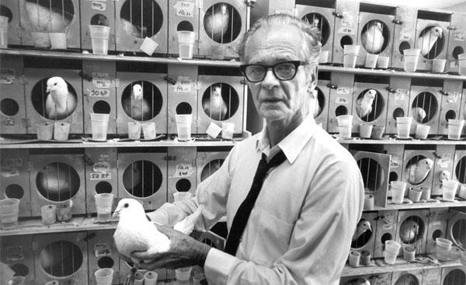
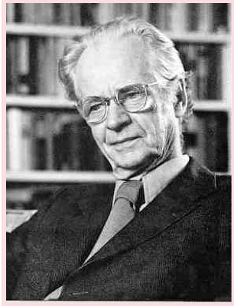
B.F. Skinner (1904-1990)
Founder of radical behaviorism:
All behaviors are learned and controlled by the situation that immediately precedes the behavior and the consequences that follow it
Acknowledged that humans have subjective experiences (mind, thoughts, and emotions)
Did not believe that subjectivity were the causes of behavior but rather, our mental processes are formed by our environment and behavior

Slide 16
What causes human behavior? Skinner, B.F. (1971). Beyond Freedom & Dignity
“...something essential to scientific practice is missing in almost all current discussions of human behavior. It has to do with our treatment of the causes of behavior.” p.7
“Man’s first experience with causes probably came from his own behavior: things moved because he moved them. If other things moved, it was because someone else was moving them, and if the mover could not be seen, it was because he was invisible.”

Slide 17
What causes human behavior? Skinner, B.F. (1971). Beyond Freedom & Dignity
“The Greek gods served in this way as the cause of physical phenomena.” They were usually outside the things they moved, but they might enter into and ‘possess’ them.”
“Physics and biology soon abandoned explanations of this sort and turn to more useful kinds of causes, but the step has not been taken in the field of human behavior.”

Slide 18
What causes human behavior? Skinner, B.F. (1971). Beyond Freedom & Dignity
“Intelligent people no longer believe that men are possessed by demons (although the exorcism if devils is occasionally practiced, and the demonic has reappeared in the writings of psychoanalysis.,
But human behavior is still commonly attributed to indwelling agents.” p.8

Slide 19
What causes human behavior? Skinner, B.F. (1971). Beyond Freedom & Dignity
“A juvenile delinquent is said, to be suffering from a disturbed personality.”
“In this example, it is assumed that there is a distinction between personality and behavior, which the former is believed in control of the latter.”
“Psychologists have identified three of these personalities -- the ego, superego, and id-- and interactions among them are said to responsible for the behavior of the man in whom they dwell.”

Slide 20
What causes human behavior? Skinner, B.F. (1971). Beyond Freedom & Dignity
“Although physics soon stopped personifying things in this way, it continued fora long time to speak as if this indwelling agent had wills, impulses, feelings, purposes”
“...the behavioral sciences still appeal to comparable internal states.”
“Almost everyone who is concerned with human behavior continues to talk about human behaviors in this prescientific way.” p.9
Notes:
““Physics and biology moved farther away from personified causes when they began to attribtude the bheavior to essences, qulaities, or natures.”

Slide 21
What causes human behavior? Skinner, B.F. (1971). Beyond Freedom & Dignity
“We are told that to control the number of people in the world we need to change attitudes toward children, overcome pride in size of family, build responsibility toward offspring, and reduce the role played by a large family in allaying concerns for old age.” p. 9-10
“To work for peace we must deal with the will to power or the paranoid delusions of leaders; we must remember that wars begin in the minds of men, that there is something suicidal in man which leads to war.”

Slide 22
What causes human behavior? Skinner, B.F. (1971). Beyond Freedom & Dignity
“To solve poverty we must inspire self-respect, encourage initiative, and reduce frustration.” To allay the disaffection of the young we must provide a sense of purpose and reduce feelings of alienation or hopelessness. Realizing that we have no effective means of doing any of this, we ourselves may experience a crisis of belief or a loss of confidence, which can be corrected only by returning to a faith in man’s inner capacities. This is staple fare. Almost no one questions it. Yet there is nothing like it in physics or biology.”

Slide 23
What causes human behavior? Skinner, B.F. (1971). Beyond Freedom & Dignity
“The dimensions of the world of mind do raise embarrassing problems, but it is usually possible to ignore them.” p. 12
“Behavior is not recognized as a subject in its own right. In psychotherapy, the disturbing things a person does or says are almost always regarded as symptoms, and compared with the dramas which are staged in the depths of the mind, behavior itself seems superficial.”
“The mental explanation brings curiosity to an end.”

Slide 24
What causes human behavior? Skinner, B.F. (1971). Beyond Freedom & Dignity
“The psychoanalyst learns about the early life if his patient almost exclusively from the patient’s memories, which are known to be unreliable, and he may even argue that what is important is not what actually happened but what the patient remembers.” p. 13
“Unable to understand how or why the person we see behaves as he does, we attribute his behaviour to person we cannot see, whose behavior we cannot explain either but about who we are not inclined to ask questions.” p.14

Slide 25
What causes human behavior? Skinner, B.F. (1971). Beyond Freedom & Dignity
“William James corrected a prevailing view of the relation between feelings and action by arguing, we do not run away because we are afraid but are afraid because we run away.” p. 13
“What we feel when we feel afraid is our behavior.”
“Whether we regard ourselves as explaining feelings or the behavior said to be caused by feelings, we give little attention to antecedent circumstances [the environmental conditions].”
Notes:
a thing or event that existed before or logically precedes another.

Slide 26
What causes human behavior? Skinner, B.F. (1971). Beyond Freedom & Dignity
“The task of a scientific analysis is to explain how the behavior of a person as a physical system is related to the conditions under which the human species evolved and the conditions under which the individual lives.” p. 14
“The contingencies of survival responsible for man’s genetic endowment would produce tendencies to act aggressively, not feelings of aggression. The punishment of sexual behavior changes sexual behavior, and any feelings which may arise are by products. Our age is not suffering from anxiety but from the accidents, crimes, wars and other dangerous and painful things to which people are so often exposed. Young people drop out of school, refuse to get jobs, and form cliques not because they feel alienated but because of defective social environments in homes, schools, factories, and elsewhere.” p. 15
Notes:
a future event or circumstance that is possible but cannot be predicted with certainty.
a small group of people, with shared interests or other features in common, who spend time together and do not readily allow others to join them.

Slide 27
What causes human behavior? Skinner, B.F. (1971). Beyond Freedom & Dignity
“We can follow the path taken by physics and biology by turning directly to the relation between behavior and the environment and neglecting supposed states of the mind.”
“...we do not need to try to discover what personalities, states of mind, feelings, traits, plans, intentions, goals of manreally are in order to get on with a scientific analysis of behavior.”

Slide 28
Skinner’s work elaborated on Thorndike's Law of Effect: https://www.youtube.com/watch?v=xZVtU08D0Rs
Notes:
Rewarded behavior is most likely to reoccur and punished behavior is less likely to occur. Ex. Puzzle box

Slide 29
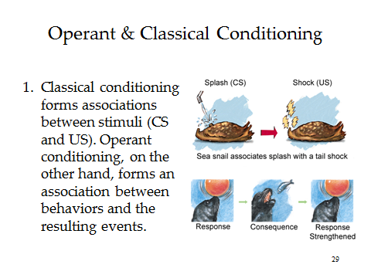

Slide 30
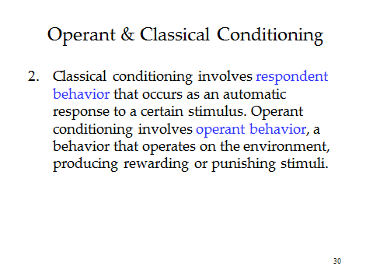

Slide 32
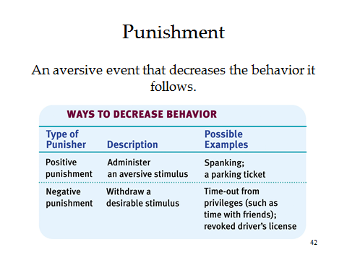

Slide 34
What causes human behavior? Skinner, B.F. (1971). Beyond Freedom & Dignity
“There is a third source of tribute. As the emphasis shifts to the environment, the individual seems to be exposed to a new danger. Who is to construct the controlling environment and to what end?” p.22
“What will the putative controller find good, and will it be good for those he controls?
Big Bang Theory: https://www.youtube.com/watch?v=qy_mIEnnlF4

